Slide 1
Chpater1
An Introduction to Software Engineering

Slide 2
Objectives
To introduce software engineering and to explain its importance
To set out the answers to key questions about software engineering
To introduce ethical and professional issues and to explain why they are of concern to software engineers

Slide 3
Why Software engineering?
Software is important, is soul of computer-based system.
  Software is indispensable in almost each domain.
  It affects nearly every aspect of our lives and has become pervasive in our commerce, our culture, and our everyday activities.
  law of unintended consequences

Slide 4
Why Software engineering?
Three ways that Software improves the current business process:
  Material flow to information flow
  Information transfer
  Logical thinking

Slide 5
Why Software engineering? (continued)
Software crisis: a set of problems present in developing software
  Over budget (bad design)
  Over schedule: delivered late
  Deficient in the stated requirements
Reasons for crisis
  complexity is inherent (essential) property¹
  Intangible (creative effort)
  Change
  No effective technology and management approach
Notes:
1 1Einstein argued that there must be a simplified explanation of nature, because God is not capricious or arbitrary. No such faith comforts the software engineer.
Much of the complexity that he must master is arbitrary complexity.” Fred Brooks

Slide 6

Software crisis
过去几十年的大型软件系统的开发就犹如这样一个焦油坑，很多大型和强壮的动物在其中剧烈地挣扎。
拉布雷阿的焦油坑（Mural of La Brea Tar Pits）

Slide 7
A classic example
美国IBM公司在1963年至1966年开发的IBM360机的操作系统。这一项目花了5000人一年的工作量，最多时有1000人投入开发工作，写出了近100万行源程序。......据统计，这个操作系统每次发行的新版本都是从前一版本中找出1000个程序错误而修正的结果。......这个项目的负责人F. D. Brooks事后总结了他在组织开发过程中的沉痛教训时说：“......正像一只逃亡的野兽落到泥潭中做垂死的挣扎，越是挣扎，陷得越深，最后无法逃脱灭顶的灾难。......程序设计工作正像这样一个泥潭，......一批批程序员被迫在泥潭中拼命挣扎，......谁也没有料到问题竟会陷入这样的困境......”。IBM360操作系统的历史教训成为软件开发项目的典型事例为人们所记取。

Slide 8
Why Software engineering? (continued)
Attack software crisis: software engineering is concerned with theories, methods and tools for professional software development.
No SE, like flash marriage

Slide 9
Why Software engineering? (continued)
But Brooks told us in book, The Mythical Man-Month:
No panacea. No silver bullet
As Brooks points out, “Einstein argued that there must be simplified explanations of nature, because God is not capricious or arbitrary. No such faith comforts the software engineer. Much of the complexity that he must master is arbitrary complexity”

Slide 10
What is Software engineering?
What is software?
What is software engineering?
What is the difference between software engineering and computer science?
What are three elements of SE
What is a software process?
What is a model?

Slide 11
What is Software engineering? (continued)
What is a software process model?
What are software engineering methods?
What is CASE (Computer-Aided Software Engineering)
What are the attributes of good software?
What are the key challenges facing software engineering?

Slide 12
What is software?
Computer programs and associated documentation such as requirements, analysis,design models and user manuals.

Slide 13
What is software engineering?
Many definitions:
Software Engineering is a collection of techniques,
methodologies and tools that help with the production of
  a high quality software system
  within a given budget
  before a given deadline
while change occurs.

Slide 14
What are three elements of SE
Software Process
Methodology
Tool: CASE

Slide 15
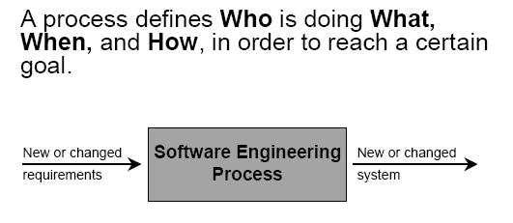
What is a software process?

Slide 16
What is a software process? (continued)
A set of activities whose goal is the development or evolution of software
Generic activities in all software processes are:
  Specification - what the system should do and its development constraints
  Development - production of the software system
  Validation - checking that the software is what the customer wants
  Evolution - changing the software in response to changing demands.

Slide 17
Software Process
Software process is complicated and includes many activities.
We should first focus on some milestone activities---Process model.

Slide 18
Review
SE
  Methodology
  Tool
  Process
    Complex, including many activities
      Modeling it.

Slide 19
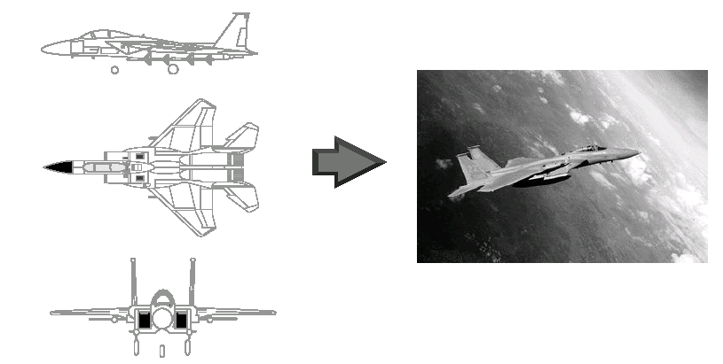
Software Process model
What is a Model?
  A model is a simplification or abstraction of reality.

Slide 20
Software Process model(continued)
Why model?
  You build models of complex systems because you cannot comprehend such a system in its entirety
  2+- 7 law

Slide 21
What is a software process model?
A simplified representation of a software process, presented from a specific perspective.
Generic process models
  Waterfall;
  Iterative development;
  Component-based software engineering.

Slide 22
What are software engineering methodologies?
SE method is a structured approach to development whose aim is to facilitate the production of high-quality software in a cost-effective way:
No method: individual hero, craft…
Programming: individual workshop小作坊
SE Method: teamwork---finding good players is easy. Getting them to play as a team is another story.

Slide 23
What are software engineering methodologies? (continued)
PO: procedural oriented : SP, SD, SA
  DFD: Data Flow Diagram ,E-R diagram
OO –our focus
  RUP
  UML: use case ,activity diagram, sequence diagram…
There is no ideal method. OO: for interactive not for real-time system
Combination PO and OO, etc.

Slide 24
What is CASE (Computer-Aided Software Engineering)
Software systems that are intended to provide automated support for software process activities.
CASE systems are often used for method support.
CASE is a Tool:
  Instrument or automated systems to accomplish a technique

Slide 25
What are the attributes of good software?
The software should deliver the required functionality and performance to the user and should be maintainable, dependable and acceptable.
Maintainability
  Software must evolve to meet changing needs;
Dependability
  Software must be trustworthy;
Efficiency
  Software should not make wasteful use of system resources;
Acceptability
  Software must accepted by the users for which it was designed. This means it must be understandable, usable and compatible with other systems.

Slide 26
Factors affecting the quality of a software system
Complexity:
  The system is so complex that no single programmer can understand it anymore
  The introduction of one bug fix causes another bug

Slide 27
Factors affecting the quality of a software system (continued)
Change:
  As time goes on, the cost to implement a change will be too high, and the system will then be unable to support its intended task. This is true of all systems .

Slide 28
Dealing with Complexity
Abstraction (Modeling)
Decomposition
Hierarchy
  Tier, layer
Notes:
Hierarchy (Booch 17):
Object model is called object structure
by Booch

Slide 29
1. Abstraction: modeling
Abstraction is one of fundamental ways that we as humans cope with complexity.
Inherent human limitation to deal with complexity
  The 7 +- 2 phenomena. Miller’s experiments: an individual can comprehend only about seven, plus or minus two, chunk information at one time.
Ignore unessential details: => Models

Slide 30
2. Decomposition
A technique used to master complexity (“divide and conquer”)
Functional decomposition---SA ,SD
  The system is decomposed into modules
  Each module is a major processing step (function) in the application domain
  Modules can be decomposed into smaller modules
Data-centered, process and data are separated.

Slide 31
2. Decomposition (continued)
Object-oriented decomposition
  The system is decomposed into classes (“objects”)
  Each class is a major abstraction in the application domain
  Classes can be decomposed into smaller classes
Human-centered, data and its process are integrated.
Which decomposition is the right one?
Notes:
Which decomposition is the right one? If you think you are politically correct, you probably want to answer: Object-oriented. But that is actually wrong. Both views are important
Functional decomposition emphasises the ordering of operations, very useful at requirements engineering stage and high level description of the system.
Object-oriented decomposition emphasizes the agents that cause the operations. Very useful after initial functional description. Helps to deal with change (usually object don’t change often, but the functions attached to them do).

Slide 32
3. Hierarchy
TCP/IP protocol
MVC

Slide 33
4. Reusability
  Do not reinvent the wheel
  Do not repeat yourself
  Be lazy
A good software design solves a specific problem but is general enough to address future problems (for example, changing requirements)
Experts do not solve every problem from first principles
  They reuse solutions that have worked for them in the past
Goal for the software engineer:
  Design the software to be reusable across application domains and designs
How?
  Use design patterns and frameworks whenever possible

Slide 34
5. Design Patterns and Frameworks
Design Pattern: (蛋炒饭）
  A small set of classes that provide a template solution to a recurring design problem
  Reusable design knowledge on a higher level than data structures (link lists, binary trees, etc)
Framework ¹
  A moderately large set of classes that collaborate to carry out a set of responsibilities in an application domain.
    Examples: User Interface Builder, MFC…
  a kind of reuse
Notes:
1 write less, do more

Slide 35
Professional and ethical responsibility
Software engineering involves wider responsibilities than simply the application of technical skills.
Software engineers must behave in an honest and ethically responsible way if they are to be respected as professionals.
Ethical behaviour is more than simply upholding the law.

Slide 36
Issues of professional responsibility
Confidentiality
  Engineers should normally respect the confidentiality of their employers or clients irrespective of whether or not a formal confidentiality agreement has been signed.
Competence
  Engineers should not misrepresent their level of competence. They should not knowingly accept work which is outside their competence.

Slide 37
Issues of professional responsibility
Intellectual property rights
  Engineers should be aware of local laws governing the use of intellectual property such as patents, copyright, etc. They should be careful to ensure that the intellectual property of employers and clients is protected.
Computer misuse
  Software engineers should not use their technical skills to misuse other people’s computers. Computer misuse ranges from relatively trivial (game playing on an employer’s machine, say) to extremely serious (dissemination of viruses).

Slide 38
Key points
Software engineering is an engineering discipline that is concerned with all aspects of software production.
Software products consist of developed programs and associated documentation. Essential product attributes are maintainability, dependability, efficiency and usability.
The software process consists of activities that are involved in developing software products. Basic activities are software specification, development, validation and evolution.
Methods are organised ways of producing software. They include suggestions for the process to be followed, the notations to be used, rules governing the system descriptions which are produced and design guidelines.

Slide 39
Key points (continued)
CASE tools are software systems which are designed to support routine activities in the software process such as editing design diagrams, checking diagram consistency and keeping track of program tests which have been run.
Software engineers have responsibilities to the engineering profession and society. They should not simply be concerned with technical issues.
Professional societies publish codes of conduct which set out the standards of behaviour expected of their members.

